Slide 1
KANBAN

Slide 2
What is Kanban?
Kanban is the result of practitioners applying lean principles to software engineering.
Kanban is influenced heavily by existing first- generation Agile methodologies.
Kanban is more like a tool than a methodology.
Notes:
Kanban is a method for managing knowledge work which balances demands for work with the available capacity for new work. Work items are visualized to give participants a view of progress and process, from task definition to customer delivery. Team members "pull" work as capacity permits, rather than work being "pushed" into the process when requested.
In software development, Kanban provides a visual process-management system which aids decision-making about what, when and how much to produce. Although the method (inspired by the Toyota Production System and lean manufacturing) originated in software development and IT, it may be applied to any professional service whose work outcome is intangible rather than physical.

Slide 3
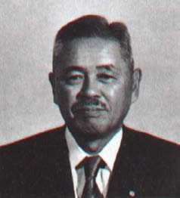
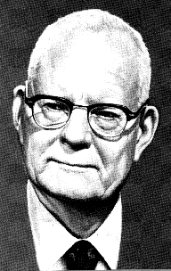
Overview Kanban
It starts with Lean Principles:
Pull
Continuous Flow
Customer Value
Waste Elimination
Continuous Improvement
Founder of Toyota
Production Systems
Taiichi Ohno
Quality Guru: System of Profound Knowledge
W. Edwards Deming
Notes:
In the late 1940s, Toyota found a better engineering process from an unlikely source: the supermarket. They noticed that store clerks restocked a grocery item by their store’s inventory, not their vendor’s supply.
Only when an item was near sellout did the clerks order more. The grocers’ “just-in-time” delivery process sparked Toyota engineers to rethink their methods and pioneer a new approach—a Kanban system—that would match inventory with demand and achieve higher levels of quality and throughput.

Slide 4

Kanban Principles
Kanban for Software’s Lean Heritage:
Don’t build features that nobody needs right now
Don’t write more specs than you can code
Don’t write more code than you can test
Don’t test more code than you can deploy
Notes:
Kanban is an approach to process change for organizations which uses visualization with a kanban board, allowing a better understanding of work and workflow. It advises limiting work in progress, which reduces waste from multitasking and context switching, exposes operational problems and stimulates collaboration to improve the system. Kanban is rooted in two sets of principles: for change management and service delivery, which emphasize evolutionary change and customer focus. The method does not prescribe a specific set of steps, but starts from existing context and stimulates continuous, incremental and evolutionary changes to the system. It aims to minimize resistance to change to facilitate it.
Kanban focuses on the customer and work which meets their needs, rather than individuals' activities. Kanban has six general practices: visualization, limiting work in progress, flow management, making policies explicit, using feedback loops, and collaborative or experimental evolution. They involve seeing the work and its process and improving the process, keeping and amplifying useful changes and learning from, reversing and dampening the ineffective.

Slide 5
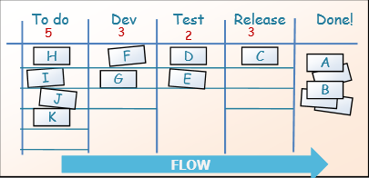
Kanban in a nutshell
Visualize the workflow
Limit WIP (work in progress)
Measure & optimize flow
Notes:
Kanban is based on 3 basic principles:
Visualize what you do today (workflow): seeing all the items in context of each other can be very informative
Limit the amount of work in progress (WIP): this helps balance the flow-based approach so teams dont start and commit to too much work at once
Enhance flow: when something is finished, the next highest thing from the backlog is pulled into play
Kanban promotes continuous collaboration and encourages active, ongoing learning and improving by defining the best possible team workflow.
The Kanban board gives you an excellent overview of your current work situation.
Visualizing work in a team environment simplifies communication and leads to improved productivity.

Slide 6




































Kanban teams
Kanban teams need just a few metrics and tools to be effective:
- Cycle time
- Lead time
- Cumulative Flow Diagrams
Kanban – example 1
Kanban – example 2
Specialist
Cross-functional team
Specialist team
Cross-functional team
Notes:
Under Kanban, no set roles are prescribed. Practically speaking, it makes sense for someone to serve as a project manager or supervisor, especially for larger more complex Kanban projects, but the roles should theoretically evolve with the needs of the project and the organization. A Kanban team is not required to be cross-functional since the Kanban work flow is intended to be used by any and all teams involved in the project. Therefore, a team of specialists and a separate team of generalists may be working on different aspects of the same Kanban project from the same board, and that’s ok.
Small teams can respect parallel processes among developers without losing visibility of the team’s work, as a whole. The horizontal swimlane in “Doing” lets the HelpDesk team share the same “To Do” and “Done” lanes as the core development team, while keeping the steps they follow unique to their teams.

Slide 7
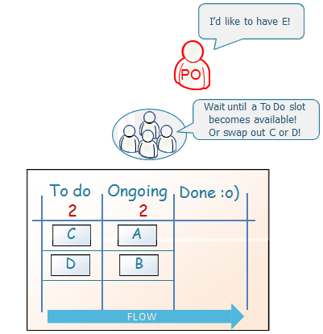
Kanban
Kanban is allow change in mid-iteration
Notes:
Allows for changes to be made to a project mid-stream, allowing for iterations and continuous improvement prior to the completion of a project.

Slide 8
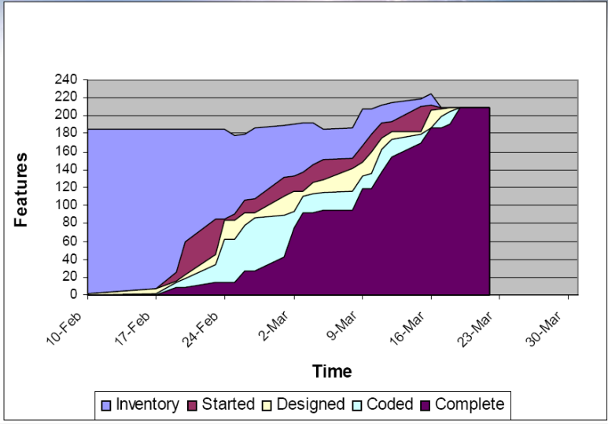
Use cumulative flow diagrams to visualize work in progress
Notes:
The Cumulative Flow Diagram shows the way the tasks mount up and their distribution along the different process stages. The graph is built from different colored bands of tasks gathered in different columns. One color per column - each band tells you how many tasks sits in what stage of the process in a given time (the horizontal value).
The best diagram you want to see is an evenly rising one, with bands staying more-less even, except for the "completed tasks" ban, which shall be continuously getting taller, as the number of tasks done is hopefully always growing.
What you don't want to see is a sudden rise within any band of tasks. This will undoubtedly point to an issue. From successive accumulation of tasks in a certain band you can also foresee bottlenecks - and by this make an effort to try to stop them. Another thing you do not want to see is the band related to tasks "in progress" widen vertically - as this means that the number of tasks being handled at present is too large and therefore the whole project will most likely be delayed.

Slide 9
Additional Considerations
Focus on system, not individual performance.
Kanban as a change management tool – evolution not revolution.
Achieve predictability by not asking developers to predict!
Know your true WIP!
Notes:
Benefits:
Shorter cycle times can deliver features faster.
Responsiveness to Change:
When priorities change very frequently, Kanban is ideal.
Balancing demand against throughput guarantees that most the customer-centric features are always being worked.
Requires fewer organization / room set-up changes to get started
Reducing waste and removing activities that dont add value to the team/department/organization
Rapid feedback loops improve the chances of more motivated, empowered and higher-performing team members

